Slide 1
AI Driven 4G/5G Cell-level energy saving
Kritadhi Chakraborty (PES2PGE24DS091)
M.Tech. DSAI, Sem. 4, thesis phase1

Slide 2
Guidance call 1

Slide 3
INTRODUCTION
Name: Kritadhi Chakraborty
Company: Rakuten Symphony
Designation: Distinguished Member of Technical Staff
Total Exp: 21+ yrs.
Domain: Wireless telecommunication
Summary: Wireless technology architect with 21 years of experience in designing and delivering RAN solutions across WCDMA, LTE, and 5G. Proven expertise in translating 3GPP specifications into deployment-grade products across diverse hardware platforms. From transformation to Open RAN architectures, including innovation through SON / RIC.
Objective: Adoption of AI/ML-based solutions to enhance RAN intelligence and automation.

Slide 4
AGENDA
Problem statement
Literature Survey
Datasets
Objectives
Next steps

Slide 5
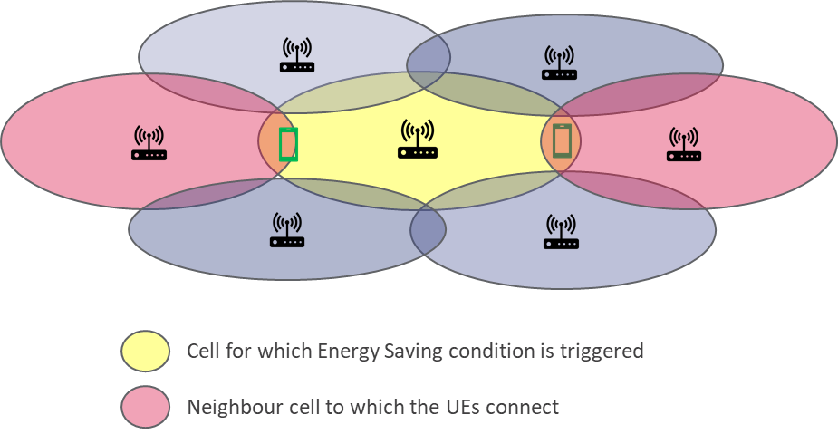
PROBLEM STATEMENT
Energy cost is one of the largest operating expenses (OPEX) for telecom operators
Cell-level energy-saving schemes are typically applied for maximum gain
The current cell-level energy-saving mechanism
The Operations & Maintenance (OAM) detects a lowly loaded cell (in terms of PRB usage and the number of connected users) and shuts it down
The operator may do it manually or set a timer for periodic shutdown
Drawbacks of the current mechanism:
It relies on the current traffic load without considering future traffic load or other factors
May result in deterioration of Energy Efficiency in the network because the future load is not considered
“5G networks are more energy efficient than their 4G predecessors... [but] in fact, a recent study estimated that the 5G system would see a 160% increase in power requirements by 2030.” — AT&T

Slide 6
Literature survey [28 papers]
AI-driven 5G-IoT optimization: Q-learning for real-time energy and network resource management | Bavethra Murthy; Palani Uthirapathy | 1 Mar 2026 | Expert Systems with Applications 298(A): 129619 | DOI: 10.1016/j.eswa.2025.129619 | Not clear from the document | Not clear from the document
Cooperative Sleep and Energy-Sharing Strategy for a Heterogeneous 5G Base Station Microgrid System | Ming Yan; Tuanfa Qin; Wenhao Guo; Yongle Hu | 21 Mar 2025 | Energies (MDPI) 18(7): 1580 | DOI: 10.3390/en18071580 | Not clear from the document | Not clear from the document
Green O-RAN Operation: a Modern ML-Driven Network Energy Consumption Optimisation | Xuanyu Liang; Ahmed Al-Tahmeesschi; Swarna Chetty; Hamed Ahmadi | Dec 2025 | arXiv preprint (arXiv:2512.07006) | arXiv: 2512.07006 | Not clear from the document | Not clear from the document
Sustainable Connections: Exploring Energy Efficiency in 5G Networks | Yibo Ma; Tong Li; Yuwei Du; Schahram Dustdar; Zhi Wang; Yong Li | 9 Dec 2024 | CoNEXT ’24 – 20th Int’l Conf. on Emerging Networking | DOI: 10.1145/3680121.3697806 | Not clear from the document | Not clear from the document
An Intelligent Energy Saving Strategy Recommendation Method of 5G Base Station Based on GBDT+FM | Tiantian Lv; Qiong Sun; Le Zhang; Yanqin Wu | Sept 2024 | IEEE MASS 2024 – 21st Int’l Conf. on Mobile Ad-Hoc and Smart Systems | DOI: 10.1109/MASS62177.2024.00082 | Not clear from the document | Not clear from the document
ML-Based Resource Allocation Scheme for Energy Optimization in 5G NR | Xiao Yao; Antonio P. Yuste | 12 Aug 2025 | Sensors (MDPI) 25(16): 4978 | DOI: 10.3390/s25164978 | Not clear from the document | Not clear from the document
Energy-Efficient BWP Configuration for Multi-Slice Users | Joe Saad; Kinda Khawam; Mohamad Yassin; Salvatore Costanzo | 17 Feb 2024 | Sensors (MDPI) 24(4): 1281 | DOI: 10.3390/s24041281 | Not clear from the document | Not clear from the document
A Comprehensive Survey of Energy Saving Techniques in 5G RAN | Xiao Yao; Antonio P. Yuste; Junyuan Wang | 6 Oct 2025 | TechRxiv preprint (IEEE)** | TechRxiv: doi:10.36227/techrxiv.24080 | Not clear from the document | Not clear from the document
When AI meets sustainable 6G | Xiaohu You; Yongming Huang; Cheng Zhang; Jiaheng Wang; Hao Yin; Hequan Wu | 24 Dec 2024 | Sci. China Information Sciences 68(2025): 110301 | DOI: 10.1007/s11432-024-4257-6 | Not clear from the document | Not clear from the document
Optimal energy-saving operation strategy of 5G base station with communication caching | Chunguang Lu; Jiaying Wang; Junzhe Huang; Tao Xiao; Lei Yan | Dec 2025 | Energy Reports (Elsevier) 14: 343–351 | DOI: 10.1016/j.egyr.2025.05.068 | No (not shared)[7] | No (not shared)[7]
Threshold-based 5G NR base station management for energy saving | Greta Vallero; Michela Meo; Wout Joseph; Margot Deruyck | Mar 2025 | Computer Networks (Elsevier) 259: 111070 | DOI: 10.1016/j.comnet.2025.111070 | Not clear from the document | Not clear from the document
Deep RL for base station switching scheme with federated LSTM-based traffic predictions | Hyebin Park; Seung Hyun Yoon | June 2024 | ETRI Journal 46(3): 379–391 (2024) | DOI: 10.4218/etrij.2023-0065 | Not clear from the document | Not clear from the document
Design and Evaluation of Deep Reinforcement Learning for Energy Saving in Open RAN | Matteo Bordin; Andrea Lacava; Michele Polese; Sai Satish; Manoj A. Nittoor; Rajarajan Sivaraj; Francesca Cuomo; Tommaso Melodia | 17 Oct 2024 | arXiv preprint (arXiv:2410.14021) | arXiv: 2410.14021 | Not clear from the document | Not clear from the document
Variational Optimization for Sustainable Massive MIMO Base Station Switching | Aida Al-Samawi; Liyth Nissirat | 14 Jan 2024 | Sensors (MDPI) 24(2): 520 | DOI: 10.3390/s24020520 | Not clear from the document | Not clear from the document
Digital Twin Backed Closed-Loops for Energy-Aware and Open RAN-based FWA | Anselme Ndikumana; Kim Khoa Nguyen; et al. | Nov 2024 | arXiv preprint (arXiv:2411.05664) | arXiv: 2411.05664 | Not clear from the document | Not clear from the document
Article Title | Authors | Published Date | Source | Link | Code Available? | Dataset Available?
Evaluation of the power-saving effect of 5G base station based on AI | Yuan Fang; Sheng Zhang; Feng Gao; Yao Cen; Xinte Qi; Ao Shen; Yunlong Liu; Jifeng Lv | May-25 | ACM (ICCIP 2024 Conference Proceedings) | DOI: 10.1145/3708657.3708673 | Not clear from the document | Not clear from the document
Enhancing energy efficiency in 5G networks through AI-driven dynamic discontinuous reception | Hammad Lazrek; Hassan El Ferindi; Mohammed Zouiten; Aniss Moumen | 30 Oct 2025 | Discover Computing (Springer, Open Access) | DOI: 10.1007/s10791-025-09765-1 | Yes (code repository provided)[1][2] | Yes (used MONROE dataset)[3][4]
A Framework for User Traffic Prediction and Resource Allocation in 5G Networks | Ioannis Konstantoulas; Iliana Loi; Dimosthenis Tsimas; Kyriakos Sgarbas; Apostolos Gkamas; Christos Bouras | 7 July 2025 | Applied Sciences (MDPI) 15(13): 7603 | DOI: 10.3390/app15137603 | Not clear from the document | Not clear from the document
Energy‑Efficient Resource Allocation in 5G Wireless Networks using Asynchronous Advantage Actor–Critic based RL | S. Padmakala; D. Manasa Spandhana; Y. M. Mahaboob John; Ammar H. Shnain; S. E. […] | Sept 2024 | IEEE ICDSCNC 2024 Conference (Proc. Distributed Systems, Networks & Cybersecurity) | DOI: 10.1109/ICDSCNC62492.2024.10941677 | Not clear from the document | Not clear from the document
Spectral efficiency enhancement and energy optimization in 5G networks via stochastic optimization-inspired modified slime mould algorithm | Vijayasankar Anumala; Fayaz A. Shaik; P. V. Kalluru; et al. | 7 Oct 2024 | Int. J. Information Technology 30: 3441–3454 (2024) | DOI: 10.1007/s41870-024-02209-x | Not clear from the document | Not clear from the document
An ultra energy-saving mechanism based on beacon signals for 6G networks | Ailin Deng; Xiaoqian Li; Gang Feng; Lu Guan | Oct 2025 | Digital Communications and Networks 11(5): 1330–1342 | DOI: 10.1016/j.dcan.2025.05.005 | Not clear from the document | Not clear from the document
Toward hyper-adaptive AI-enabled 6G networks for energy efficiency: techniques, classifications and tradeoffs | Mariem Zayene; Oussama Habachi; Gérard Chalhoub | Nov 2025 | arXiv preprint (arXiv:2511.16296) | arXiv: 2511.16296 | Not clear from the document | Not clear from the document
Dynamic Multi-Sleeping Control with Diverse Quality-of-Service Requirements in Sixth-Generation Networks Using Federated Learning | Tianzhu Pan; Xuanli Wu; Xuesong Li | 30 Jan 2024 | Electronics (MDPI) 13(3): 549 | DOI: 10.3390/electronics13030549 | Not clear from the document | Not clear from the document
Deep Learning-Based Traffic-Aware Base Station Sleep Mode and Cell Zooming Strategy in RIS-Aided Multi-Cell Networks | Shuo Sun; Chong Huang; Gaojie Chen; Pei Xiao; Rahim Tafazolli | 25 Dec 2024 | arXiv preprint (arXiv:2412.18983) | arXiv: 2412.18983 | Not clear from the document | Not clear from the document
Dynamic Hierarchical Reinforcement Learning Framework for Energy-Efficient 5G Base Stations in Urban Environments | Dianlei Xu; Xiang Su; Gopika Premsankar; Huandong Wang; Sasu Tarkoma; Pan Hui | Jan 2025 | IEEE Trans. on Mobile Computing (early access) | DOI: 10.1109/TMC.2025.3557280 | Not clear from the document | Not clear from the document
Optimizing resource allocation in 5G wireless networks for enhanced spectral efficiency and energy conservation using machine learning methods | P. Periyathambi; G. Ravi | 26 June 2024 | Signal, Image and Video Processing 18: 4961–4977 (2024) | DOI: 10.1007/s11760-024-03159-4 | Not clear from the document | No (no dataset used)[5][6]
Deep RL for Sleep Control in 5G and Beyond RAN: An Overview | Nessrine Trabelsi; Rihab Maaloul; Lamia Chaari Fourati; Wael Jaafar | May 2024 | IEEE IWCMC 2024 – 20th Int’l Wireless Comm. & Mobile Computing Conf. | DOI: 10.1109/IWCMC61514.2024.10592464 | Not clear from the document | Not clear from the document
Energy-saving control strategy for ultra-dense network base stations based on multi-agent reinforcement learning | Yan Zhen; Litianyi Tao; Dapeng Wu; Tong Tang; Ruyan Wang | Aug 2025 (online Jan 2026) | Digital Communications and Networks 11(4): 1007–1017 | DOI: 10.1016/j.dcan.2024.10.015 | Not clear from the document | Not clear from the document

Slide 7
Datasets [1/2]
Dataset / Paper | Type | Network Focus | Publicly Available? | Notes / Link
Dataset | Real measurement dataset | 5G | Yes (Gated) | 5G Network Energy Consumption Dataset (Netop) https://huggingface.co/datasets/netop/5G-Network-Energy-Consumption This dataset provides normalized real-world measurements of energy consumption and operational data from a large-scale 5G network deployment. It includes eight days of measurements collected from more than 1,000 RRU/AAUs, covering 12 different hardware products. The dataset is intended to support research in energy-efficient mobile networks, network optimization, and data-driven modeling of 5G systems. Dataset Structure The dataset is organized into three main CSV files: 1. BSinfo.csv – Base Station Basic Information Contains static information about the deployed base stations and their cells. Fields: BS: Identifier of the base station CellName: Cell identifier (multiple cells can be configured per BS, named CellX) RUType: Radio unit product name Mode: Transmission mode Bandwidth: Normalized cell bandwidth Frequency: Normalized cell frequency Antennas: Number of antennas TXpower: Maximum transmit power of the cell | 2. CLstat.csv – Cell-Level Statistics Contains hourly counters describing the operational status of each cell. Fields: Time: Timestamp of the measurement BS: Identifier of the base station CellName: Cell identifier Load: Load of the cell (share of used resources) EnergySavingMode: Intensity of activation of energy-saving mechanisms 3. ECstat.csv – Energy Consumption Contains hourly measurements of energy consumption per base station. Fields: Time: Timestamp of the measurement BS: Identifier of the base station Energy: Energy consumption of the base station Data Summary Measurement period: 8 days Number of RRUs/AAUs: > 1,000 Hardware diversity: 12 different product types Granularity: Hour-level measurements for load, counters, and energy consumption

Slide 8
Datasets [2/2]
Dataset / Paper | Type | Network Focus | Publicly Available? | Notes / Link
Dataset | Derived, public dataset | 4G/5G | Yes | 5G Energy Consumption Dataset (Kaggle) https://www.kaggle.com/datasets/nadiatriki/5g-energy-consumption-dataset
Dataset | Real measurement dataset | 4G/5G | Yes | https://github.com/tsinghua-fib-lab/NetData FIB LAB, Tsinghua University The dataset provides measurement reports, including traffic volume, energy consumption, and base station attributes for city-scale mobile networks. It includes data from over 10,000 4G base stations and 5,000 5G base stations, capturing the complexity of real-world network operations. To support the research community, we have published a portion of the dataset, including complete record traces of all base stations over one weekday and one weekend. Items collected Description Base station ID An unique identification for the base station Cell ID An unique identification for the cell Timestamp The time the record was gathered PRB usage ratio The percentage of the cell's total available physical resource blocks (PRB) that are currently being utilized, measured in % Traffic volume Average volume of traffic, measured in KBytes # of users Average number of users served BBU energy Energy consumption of the base station's baseband unit (BBU), measured in Kilo Watt Hours RRU energy Energy consumption of the cell's remote radio unit (RRU), measured in Kilo Watt Hours Channel Shutdown time Average time of the cell is in channel shutdown control, measured in Millisecond Carrier Shutdown time Average time of the cell is in carrier shutdown control, measured in Millisecond Deep sleep time Average time of the cell is in deep sleep mode, measured in Millisecond

Slide 9
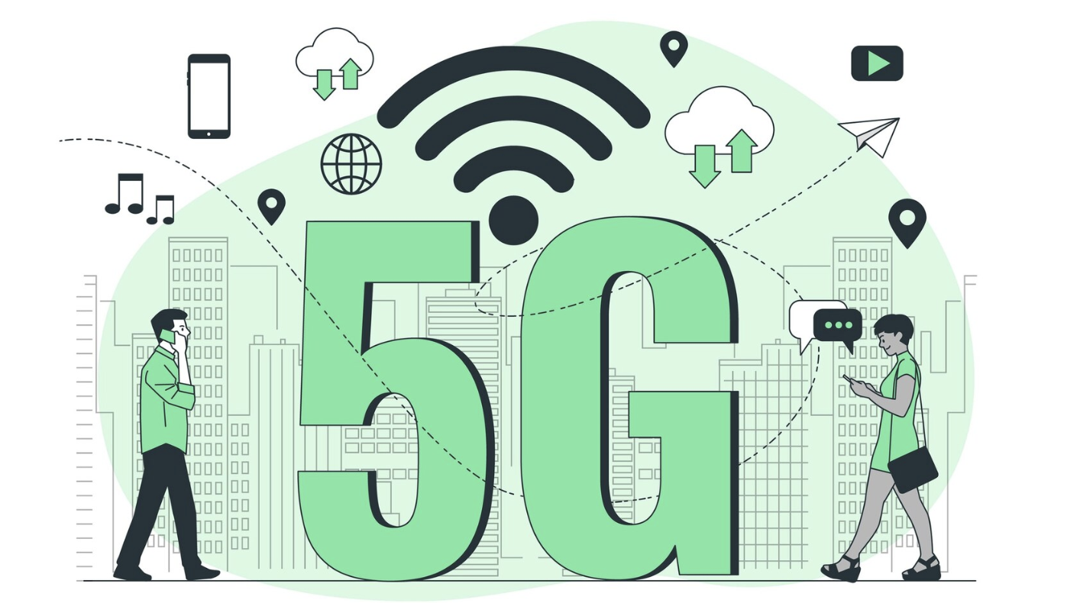
OBJECTIVES
Build a predictive model to estimate energy consumption of 5G base stations.
Analyze the impact of:
Traffic load and network usage patterns.
Engineering configurations (e.g., number of antennas, transmission power).
Energy-saving methods like sleep modes or adaptive configurations.
Features include:
Traffic volume
Number of connected users
Power configuration settings
Time of day / load profiles
Energy-saving mode status
Target variable:
Energy consumption (in kWh or equivalent metric)
Benefits:
Identifies periods where network can be put in low power, automatically triggers cell switch off, identifies times where certain cells need to be switched back on
Optimize OPEX for the operators retaining good user experience

Slide 10

POSSIBLE FEATURE ENGINEERING
a) Post Energy Saving outcome
Number of Users that could not be handed over to the neighbour cell
Number of Users that faced re-establishment in neighboring cells
Load (PRB usage, Number of Users) on neighboring cells
Duration of sleep
b) Location (City, Suburban, …)
c) Time of day
d) Weather conditions (Temperature, Humidity, …)
e) Events (Festivals, …)

Slide 11
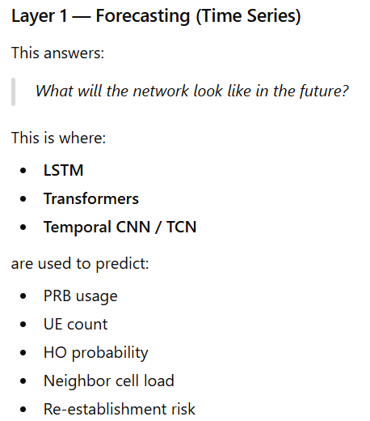
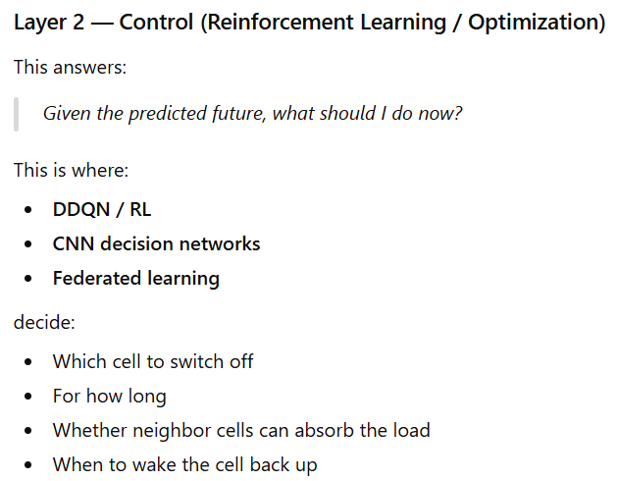
Next steps – high level WORK AREAS
Time Series Forecasting → Decision Optimization → Network Control

Slide 12
review call 1

Slide 13
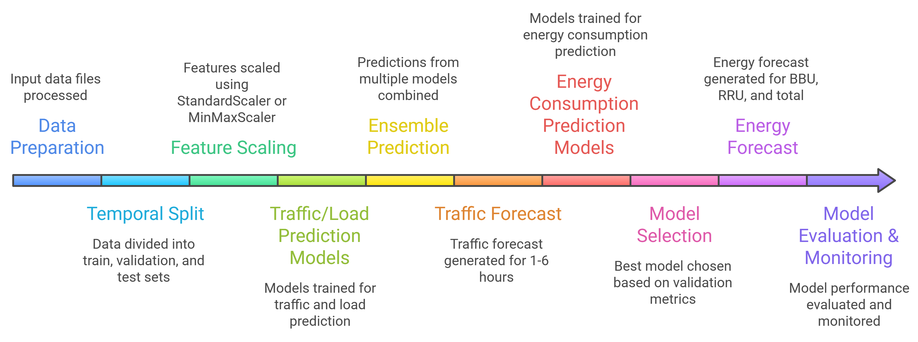
Workflow
Aspect | Netop | FIB LAB 4G | FIB LAB 5G
Base Stations | 816 | 12162 | 5165
Duration | 6 days | 1 day each | 1 day each
Granularity | 1 hour | 30 min | 30 min
Hardware Info | Detailed | None | None
Energy Saving | ES modes | No | Detailed
Scale | Medium | Very Large | Large
Use Case | Hardware optimization | 4G baseline | 5G optimization

Slide 14
EDA – 5G Network Energy Consumption Dataset (Netop)
📊 Size: Medium-scale (816 stations, 72K records)
⏱️ Temporal: Hourly for 6 days
🔧 Hardware: 12 types, highly diverse
⚡ Energy: Normalized values (3.59-100)
📈 Load: 0-99.4%, mean 25.5%
💤 ES Modes: Available but underutilized
🎯 Quality: High (real production data)
# | Filename | Description | Key Insights
1 | `01_energy_time_series.png` | Hourly and daily energy consumption over 6 days | Clear diurnal patterns; daily variation
2 | `02_load_time_series.png` | Cell load variation over time | Matches energy patterns; peak hours visible
3 | `03_hourly_patterns.png` | Energy and load by hour with peak identification | Peaks at 8-10 AM and 5-7 PM
4 | `04_distributions.png` | Histograms and box plots of energy; load; ES mode | Mostly low-medium load; ES rarely active
5 | `05_correlation_heatmap.png` | Feature correlation matrix | Load-Energy: 0.74; strong relationship
6 | `06_hardware_analysis.png` | Energy/load by RU type; mode; bandwidth | 3x energy variation across RU types
7 | `07_energy_saving_analysis.png` | ES mode effectiveness on energy consumption | ~15% reduction when ES active
8 | `08_peak_vs_offpeak.png` | Comparison of peak and off-peak hours | Peak hours show 25% higher energy
9 | `09_lagged_features.png` | Current vs lagged values for prediction | Strong autocorrelation; good for forecasting

Slide 15
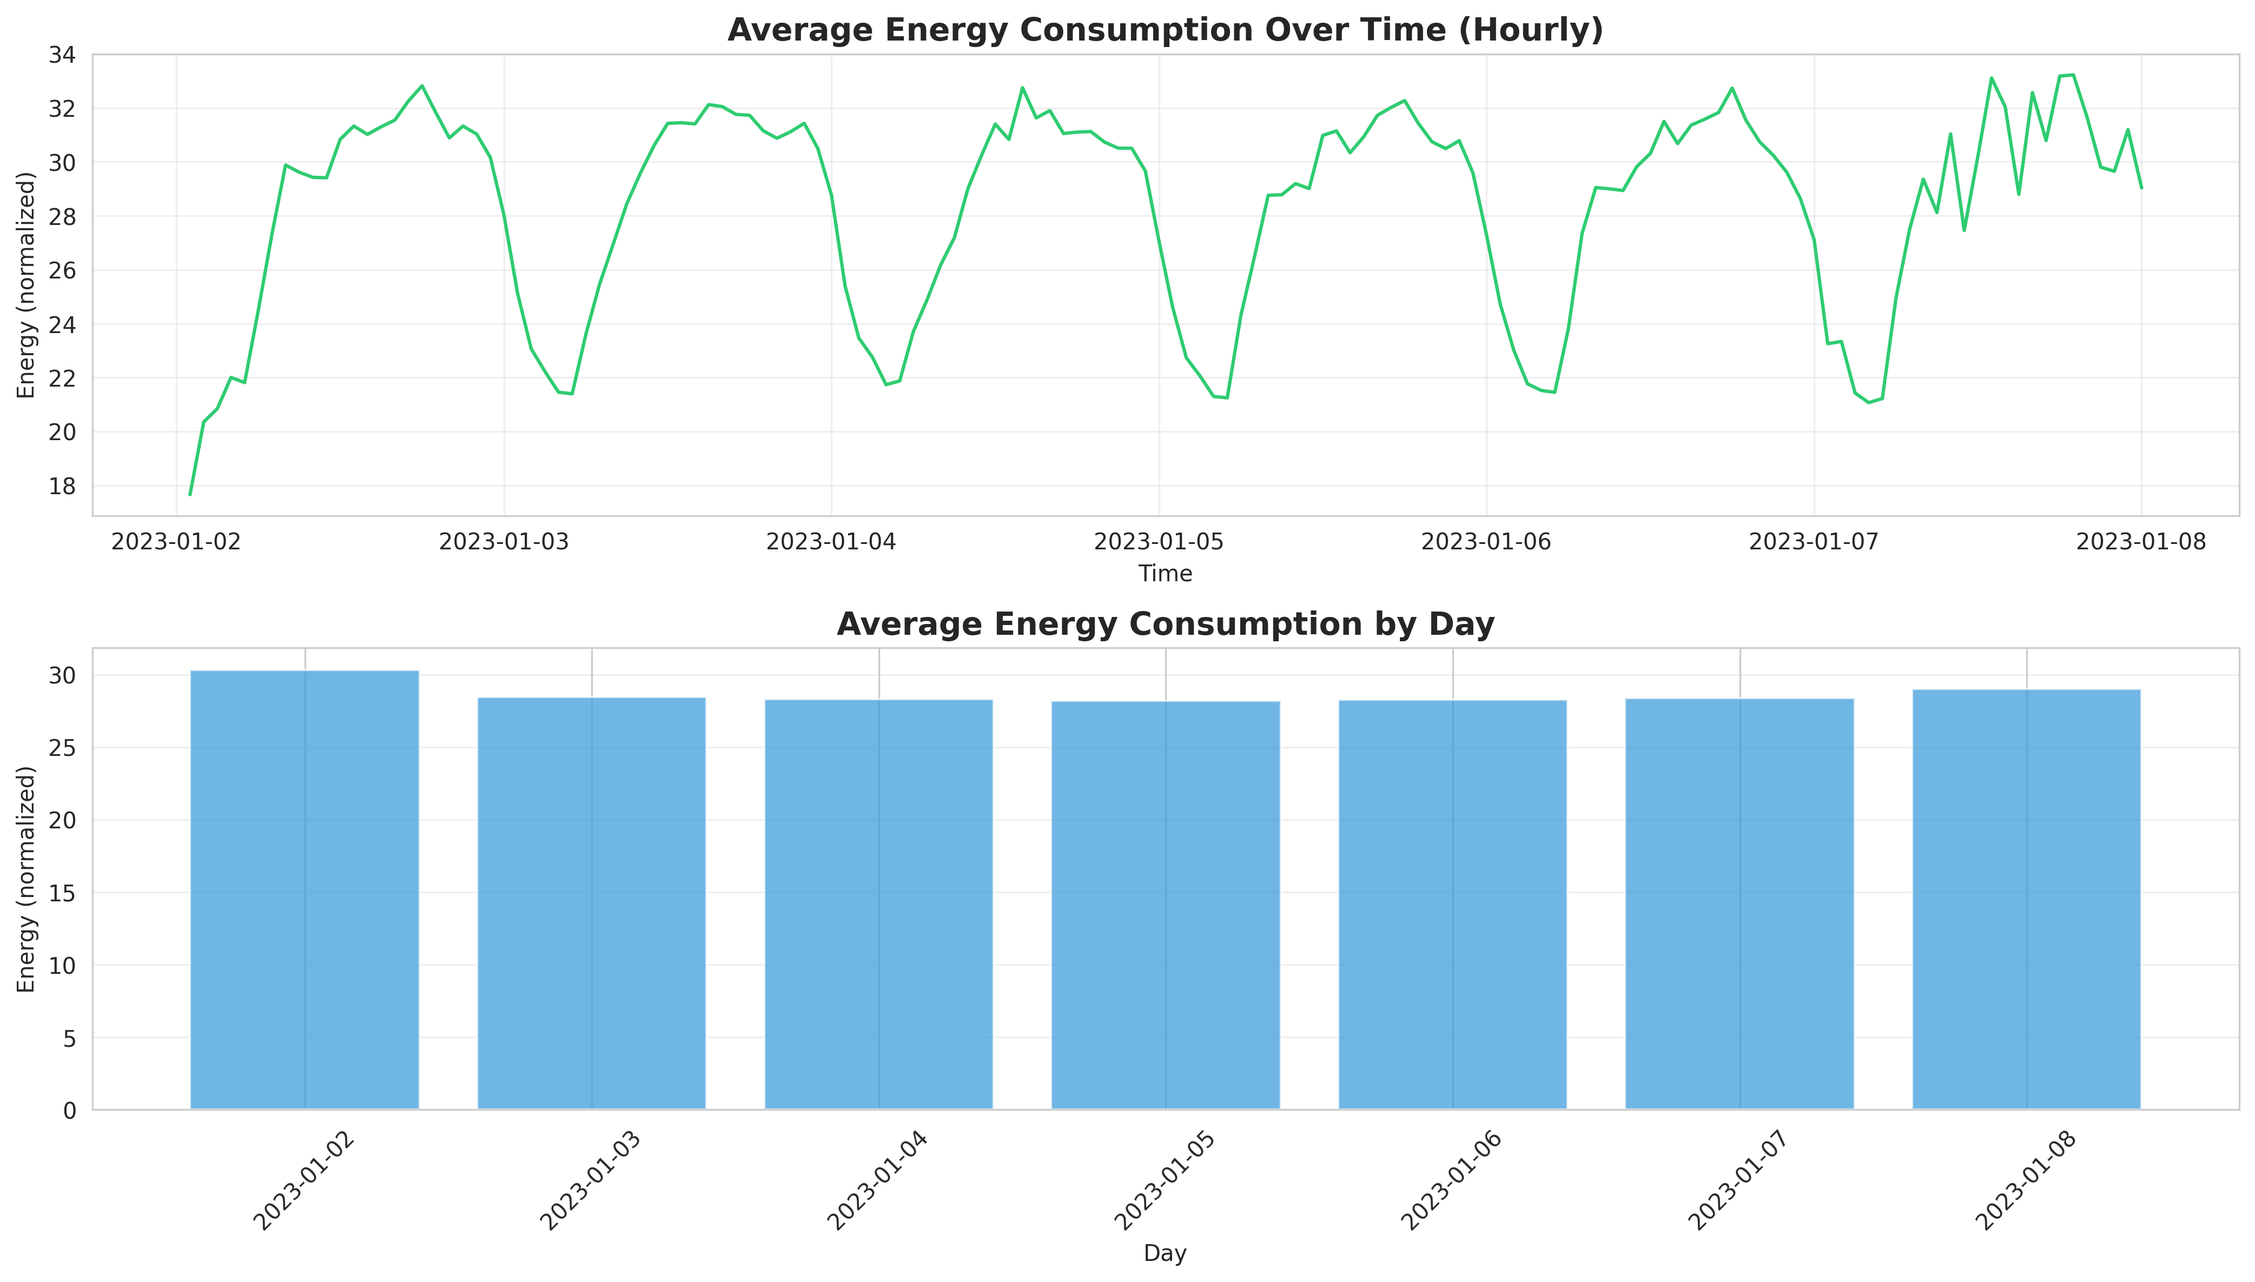
EDA – 5G Network Energy Consumption Dataset (Netop)

Slide 16
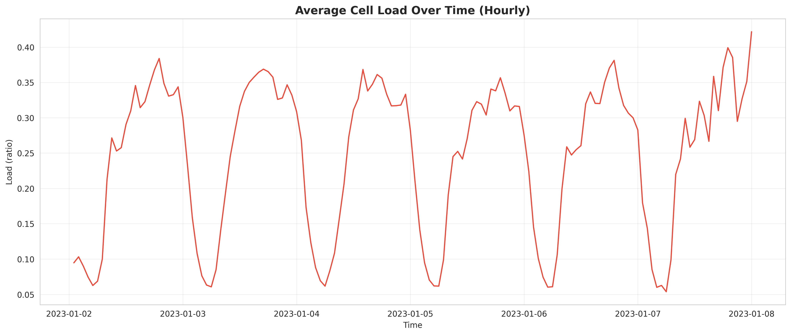
EDA – 5G Network Energy Consumption Dataset (Netop)

Slide 17
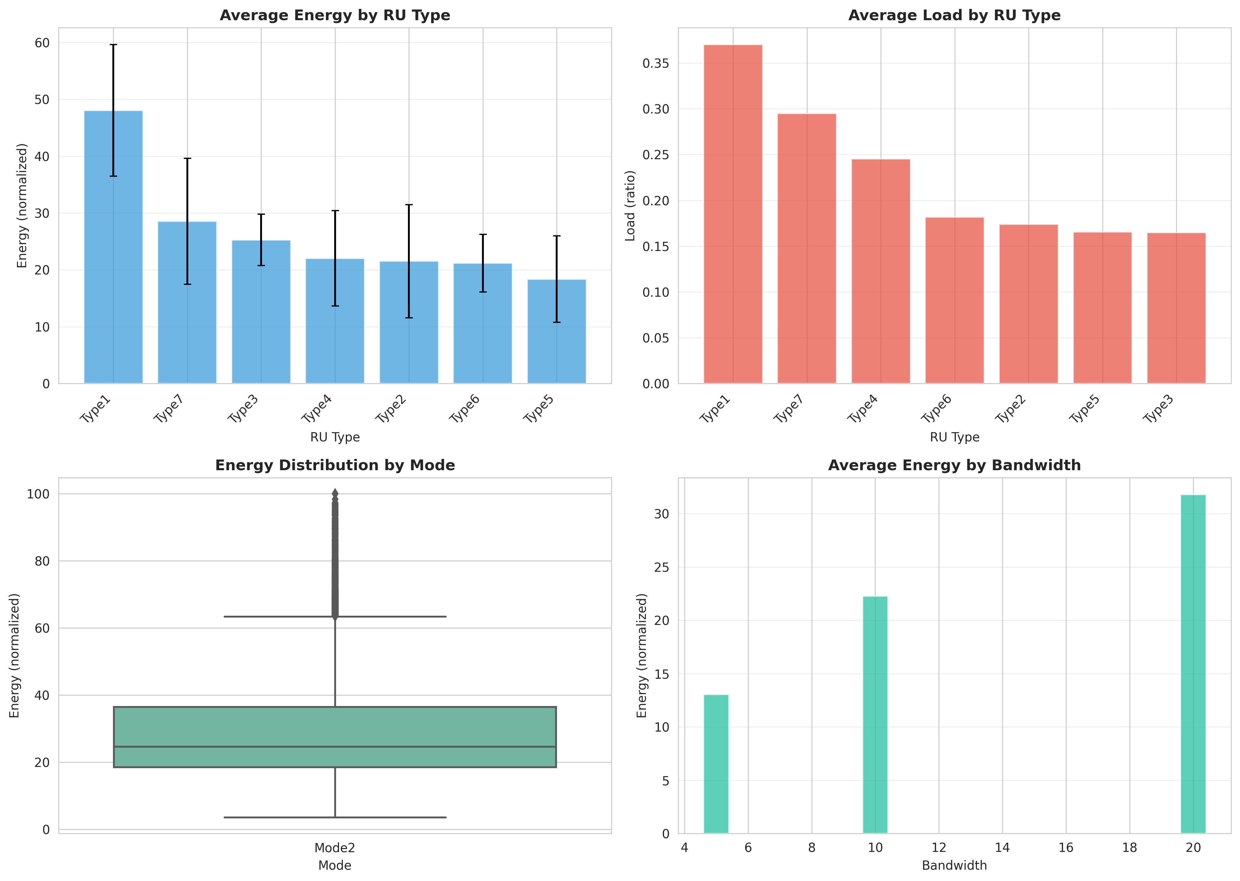
EDA – 5G Network Energy Consumption Dataset (Netop)

Slide 18
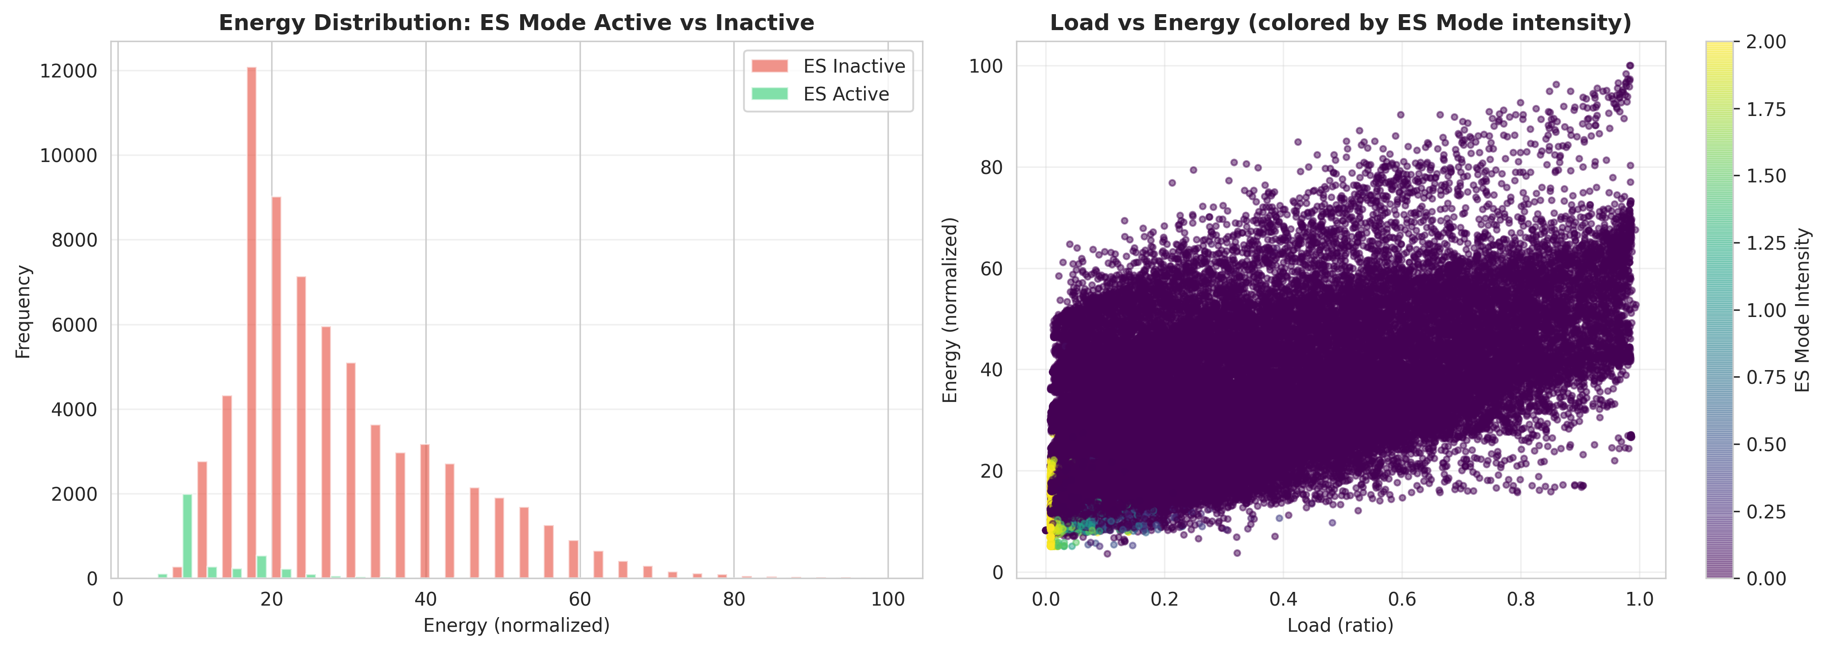
EDA – 5G Network Energy Consumption Dataset (Netop)

Slide 19
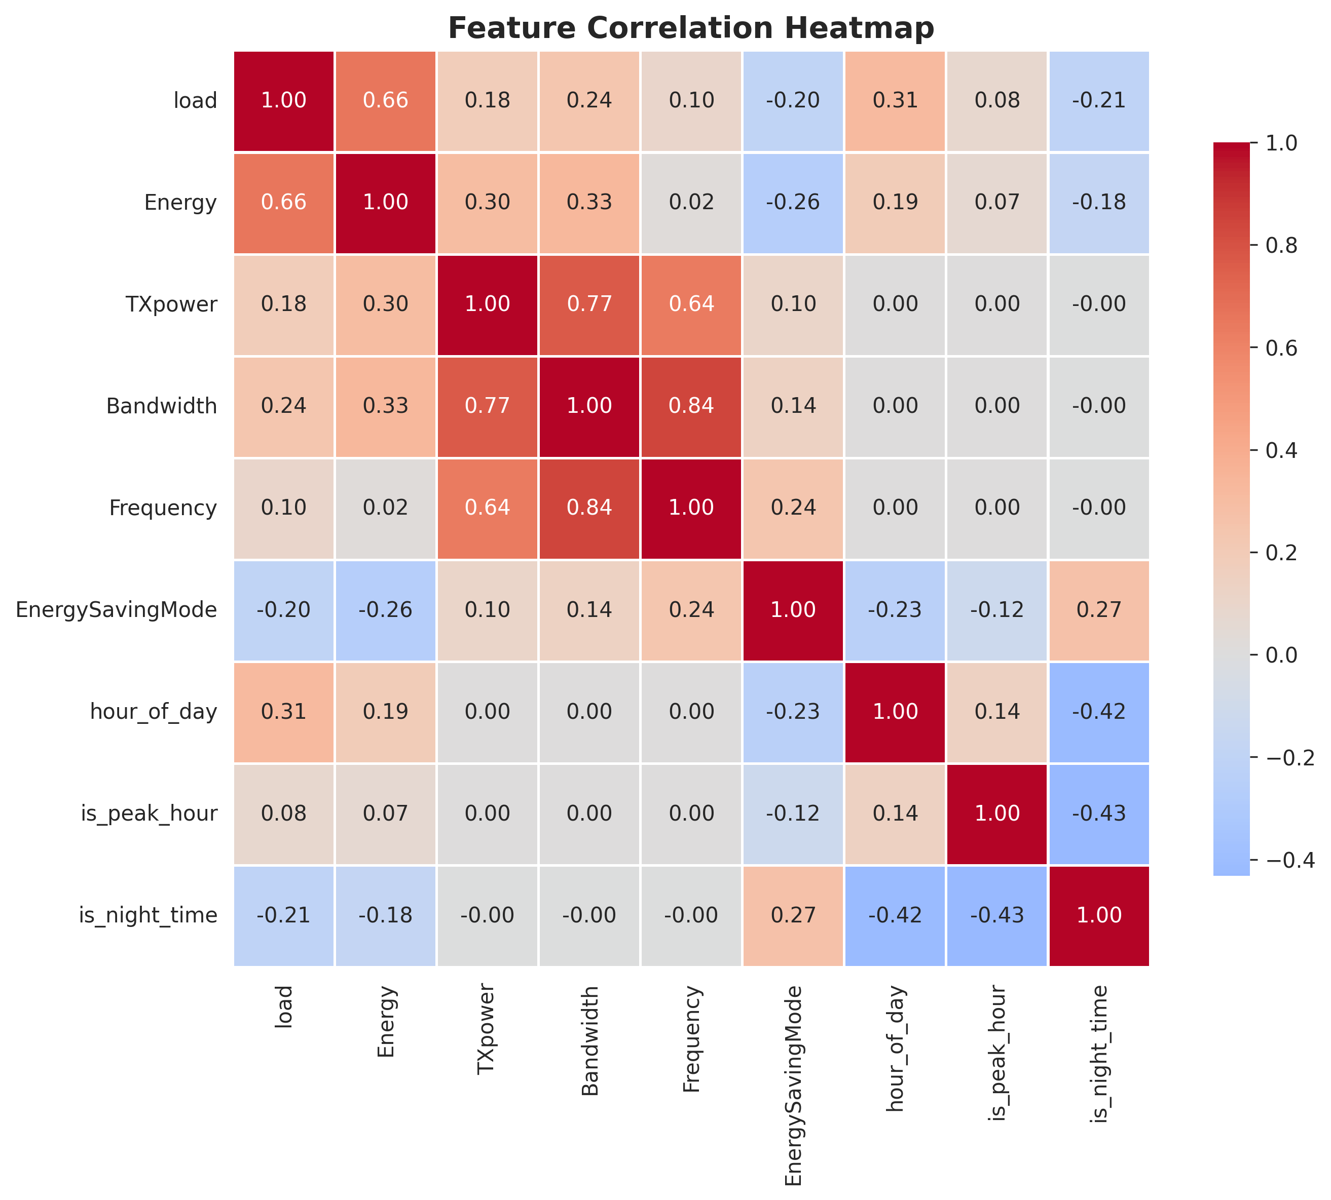
EDA – 5G Network Energy Consumption Dataset (Netop)

Slide 20
SUMMARY – 5G Network Energy Consumption Dataset (Netop)
1. Load is King (r=0.74)
Cell load is the strongest predictor of energy consumption
Hardware and temporal features are secondary
2. Hardware Matters Enormously (3x variation)
Different RU types consume drastically different energy (50-100% difference)
Choosing the right hardware can cut energy in half
3. Strong Temporal Patterns
Clear morning (8-10 AM) and evening (5-7 PM) peaks
Peak hours: 18% more energy than off-peak
Highly predictable 24-hour cycles
4. Energy Saving Underutilized (15% savings available)
ES modes only active 3-5% of the time
When active, they reduce energy by ~15%
Huge optimization opportunity
5. Excellent Predictability
Lag-1 hour correlation: 0.82-0.85
Time series models will work very well
Short-term forecasting (1-6 hours) highly feasible

Slide 21
EDA – FIB LAB 4G Network Visualizations
# | Filename | Description | Key Insights
1 | `01_time_series.png` | Energy; PRB usage; users over time | Lower PRB usage than 4G
2 | `02_weekday_vs_weekend.png` | Traffic pattern comparison | Similar patterns; higher traffic volumes
3 | `03_hourly_patterns.png` | Diurnal patterns with peak identification | Consistent peak hours
4 | `04_distributions.png` | BBU/RRU/Total energy; PRB; traffic; users | Higher energy than 4G
5 | `05_correlation_heatmap.png` | Feature relationships including ES intensity | ES intensity: -0.3 with energy
6 | `06_energy_components.png` | BBU vs RRU energy breakdown | RRU: 53%; BBU: 47%
7 | `07_energy_saving_modes.png` | Channel/carrier shutdown; deep sleep | Deep sleep most used (60ms avg)
8 | `08_energy_saving_effectiveness.png` | Impact of ES on energy consumption | ES active: 15-20% energy reduction
9 | `09_efficiency_metrics.png` | Traffic per PRB/user; energy efficiency | Higher efficiency than 4G
10 | `10_peak_vs_offpeak.png` | Comparison including ES intensity | ES more active in off-peak
11 | `11_summary_statistics.png` | KPIs; coverage; ES statistics | 5K+ base stations; 10% ES active
# | Filename | Description | Key Insights
1 | `01_time_series.png` | Energy; PRB usage; users over time (weekday+weekend) | Clear weekday/weekend patterns
2 | `02_weekday_vs_weekend.png` | Traffic pattern comparison by day type | Weekend ~10% lower traffic
3 | `03_hourly_patterns.png` | Diurnal patterns with peak identification | Strong morning/evening peaks
4 | `04_distributions.png` | BBU/RRU/Total energy; PRB; traffic; users | Right-skewed distributions
5 | `05_correlation_heatmap.png` | Feature relationships | PRB-Energy: 0.82; very strong
6 | `06_energy_components.png` | BBU vs RRU energy breakdown | RRU: 56%; BBU: 44% of total
7 | `07_efficiency_metrics.png` | Traffic per PRB/user; energy efficiency | High variance in efficiency
8 | `08_load_vs_energy.png` | Multi-dimensional scatter plots | Non-linear relationships visible
9 | `09_peak_vs_offpeak.png` | Comprehensive comparison | Peak: 1.3x energy; 1.5x traffic
10 | `10_summary_statistics.png` | KPIs and coverage summary | 12K+ base stations; 48K+ cells

Slide 22
Thank you

